Slide 1

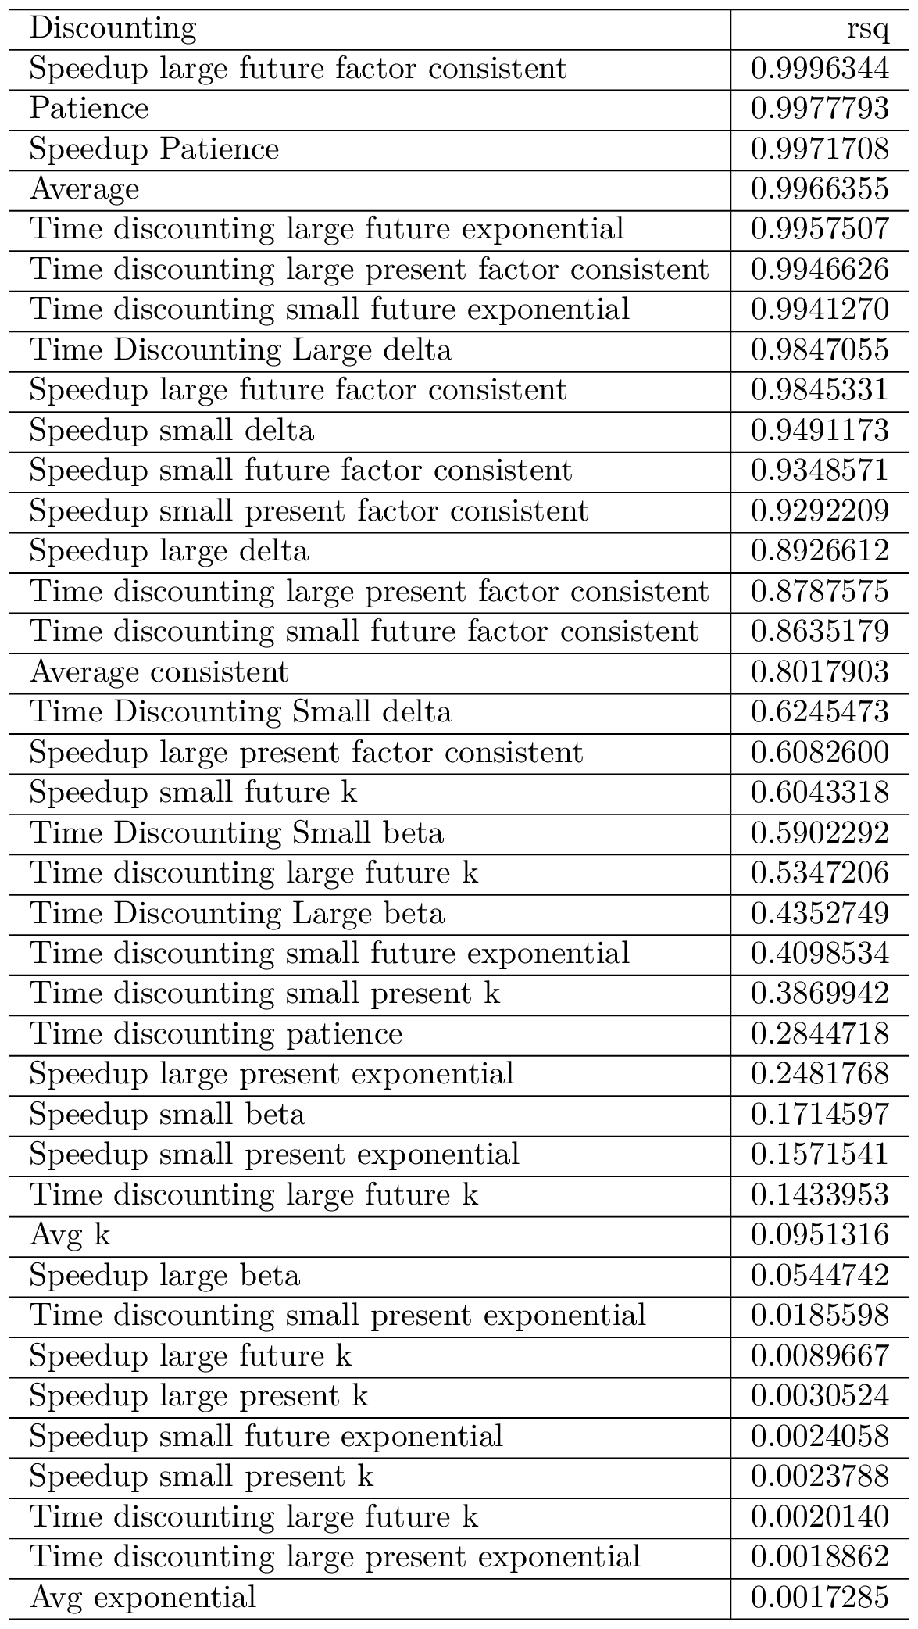
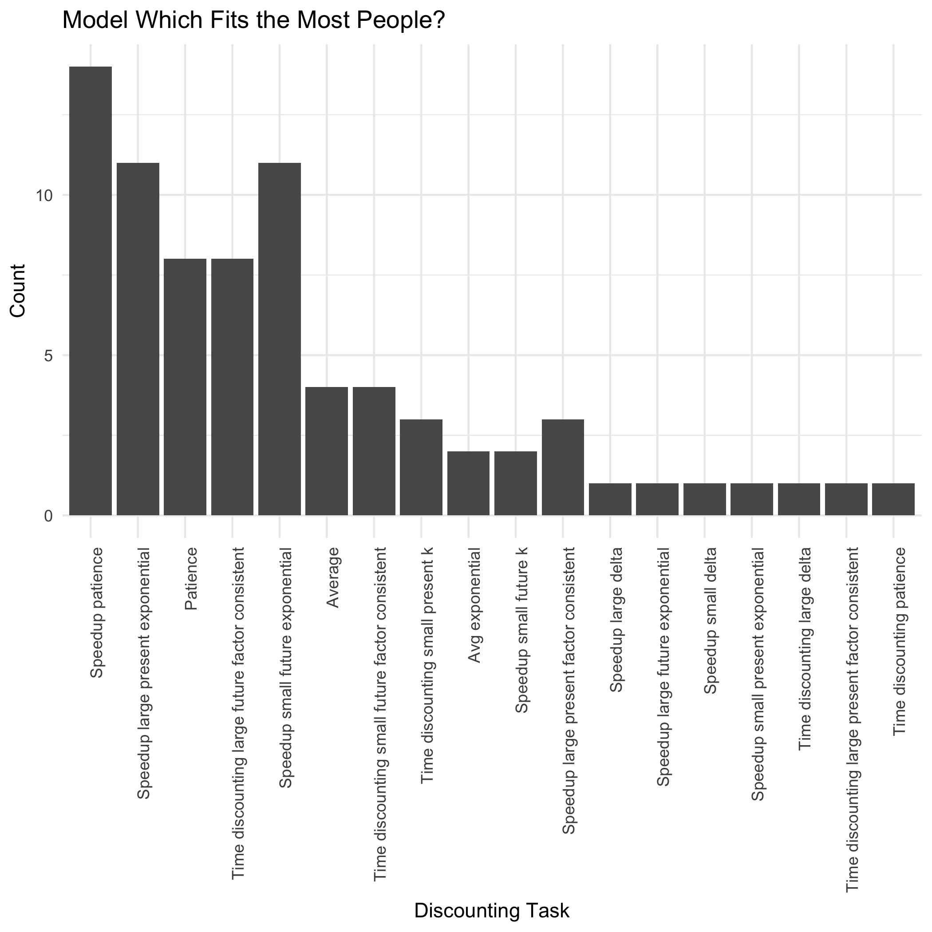
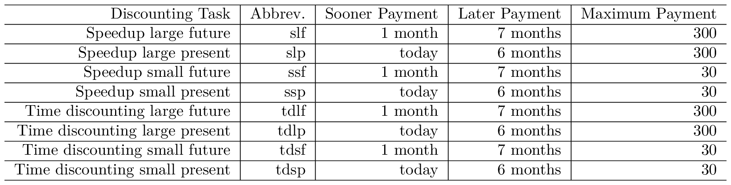
Temporal Discounting and Behavior
John-Henry Pezzuto
Computational Social Science, University of Chicago
Background
Methods - Discounting
Methods - Computation
Results – Table 2. R Squared Values by Discount Method
Conclusions
Monetary Delay Discounting is a technique used in economics, psychology and business to measure tradeoffs over time. It is solicited by finding an individuals’ indifference point by asking them a series of “now or later” questions about money, and assessing the point at which participants value both options equally.
However, because discount rates can be calculated many different ways, and discounting questions can be asked many ways, it is unclear which method is most efficient to assess behavior.
A total of 8 different methods were used to elicit discounting, each with a 6 month delay between the sooner and the later payments. These 8 different methods can be divided into two categories (speed-up and binary time discounting) that varied by both size of payment, and delay of first payment. In the speed-up measure, participants stated how much they would be willing to pay to speed up delivery of a later payment to a sooner time period. In the binary time discounting measure, participants simply chose if they would prefer the sooner or later payment. A total of 16 questions were used by each method (for a total of 128 discounting questions). Table 1. summarizes the 8 methods used to elicit discounting.
Once the indifference points were established, discount rates were measured via hyperbolic (k), exponential, beta-delta (quasi-hyperbolic), patience (proportion of later but larger choices), and discount factors (indifference / later but larger).
Data were collected via Amazon mTurk. A total of 77 (50 males, 27 females) participants were used in the analysis.
Because our feature set contained collinearity, ridge regression was used to create a model that reduced variance and mitigated collinearity. Ridge regression reduces variance by imposing constant lambda and beta constraint to the regression system, to minimize the penalized sum of squares. Lambda was estimated by selecting the log lambda that offered the lowest mean squared error.
Additionally, each participant was categorized into a discount rate model, by feeding them into each of the ridge regression model.
This allowed us to
categorize participants
by which model offered
the lowest sum of squares
error. Results are
summarized in the Best
Model Fit graph.
The results (Table 2) indicate speedup large future factor consistent is best predicted by behavior, followed closely with overall patience, speedup patience, and the average of all the factors. The time discounting large future model fit most closely with the exponential model, and time discounting large values fit most closely with the best delta model.
In regard to best model fit, our model was most able to predict the speedup patience, followed by the speedup large present exponential, and speedup small future exponential, suggesting that the speedup method may be most congruent with human behavior.
Specific Aims
Temporal discounting has been associated with a large number of behaviors in the past, sometimes with conflicting results. This survey intended to offer confirmatory evidence for established behaviors, exploratory evidence for newly established behaviors, and explore which method is the strongest predictor of behavior. Overall, participants were measured on over 100 behaviors.
Limitations
Results – Best Model Fit
The survey was limited to Amazon mTurk workers. All discounting questions were hypothetical instead of using real payments. Survey was fairly long, with the 80th percentile at just under 20 minutes – possibly causing survey takers to be affected by fatigue.
Table 1. Measures of Temporal Discounting
Acknowledgements
Special thanks to Professor Oleg Urminsky for his excellent guidance, support, and for being an overall wonderful advisor; Rick Evans & Benjamin Soltoff for their encouragement and everlasting patience.
Contact John-Henry at pezzuto@uchicago.edu

